Slide 1


Jolanda T
17-07-2024

Slide 2

Outline
Executive Summary
Introduction
Methodology
Results
Conclusion
Appendix

Slide 3
Executive Summary
Summary of methodologies
Data Collection through API
Data Collection with Web Scraping
Data Wrangling
Exploratory Data Analysis with SQL
Exploratory Data Analysis with Data Visualization
Exploratory Data Analysis with Folium
Machine Learning Prediction
Summary of all results
Exploratory Data Analysis result
Interactive analytics in screenshots
Predictive Analytics result

Slide 4
Introduction
Project background and context
SpaceX advertises Falcon 9 rocket launches on its website with a cost of 62 million dollars. Other providers costs upward of 165 million dollars each, much of the savings is because SpaceX can reuse the first stage. Therefore, if we can determine if the first stage will land, we can determine the cost of a launch. This information can be used if an alternate company wants to bid against SpaceX for a rocket launch.
The object is to evaluate the viability of the new company SpaceY to compete with SpaceX
Problems you want to find answers
What factors determine if the rocket will land successfully?
The interaction amongst various features that determine the success rate of a successful landing
What operating conditions needs to be in place to ensure a successful landing program?
What is the best way to estimate the total cost for launches?

Slide 5

Section 1

Slide 6
Methodology
Executive Summary
Data collection methodology:
The data was collected using:
SpaceX API (https://api.spacexdata.com/v4/rockets/)
Web scraping from Wikipedia (https://en.wikipedia.org/w/index.php?title=List_of_Falcon_9_and_Falcon_Heavy_launches)
Perform data wrangling
One-hot encoding was applied to categorical features
Perform exploratory data analysis (EDA) using visualization and SQL
Perform interactive visual analytics using Folium and Plotly Dash
Perform predictive analysis using classification models
Data that was collected until this step were normalized, divided in training data set and test data set and evaluated by four different classification models. The accuracy of each model is evaluated using different combinations of parameters.

Slide 7
Data Collection
Data sets were collected from SpaceX API: (https://api.spacexdata.com/v4/rockets/)
and from Wikipedia: https://en.wikipedia.org/w/index.php?title=List_of_Falcon_9_and_Falcon_Heavy_launches).
For the SpaceX API the get request was used. Next, we decoded the response content as a Json using json() function call and turn it into a pandas dataframe using .json_normalize() .
Then the data was cleaned, missing values are checked and filled where necessary.
In addition, we performed web scraping from Wikipedia for Falcon 9 launch records using BeautifulSoup.
The objective was to extract the launch records as HTML table, parse the table and convert it to a pandas dataframe for future analysis.

Slide 8
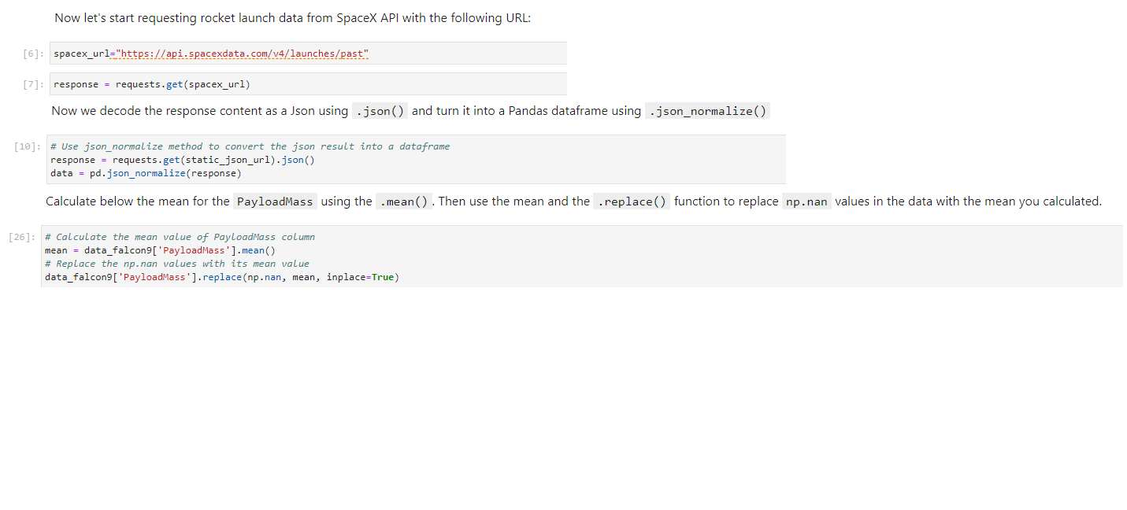
Data Collection – SpaceX API
SpaceX offers a public API form where data can be obtained and then used.
First, we request the data using the get request.
I used .json() to decode the response content.
Then used pd.json_normalize() method to convert the json result into a dataframe
Last step is the cleaning of the data
GitHub reference: https://github.com/Jolanda412/Coursera/blob/c5e743276e3359bd5902cd6e2ba330b542ddc3a6/jupyter-labs-spacex-data-collection-api.ipynb
Place your flowchart of SpaceX API calls here

Slide 9
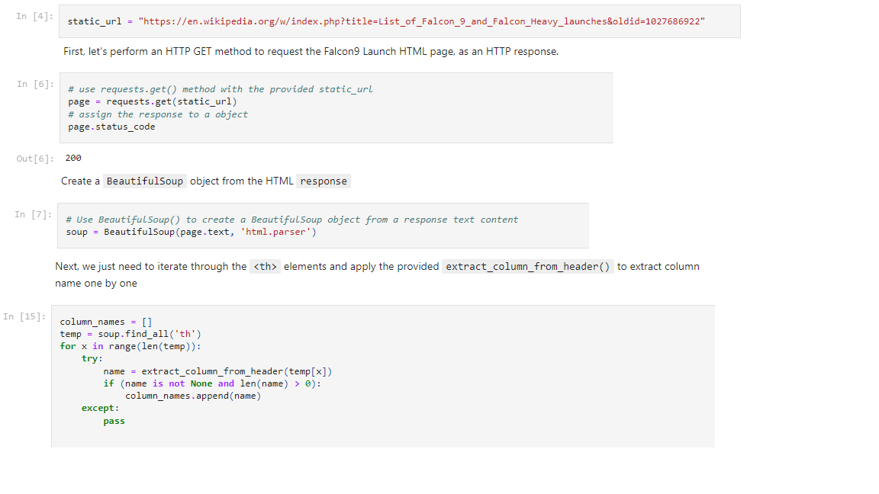
Data Collection - Scraping
First, we perform a HTTP GET method to request the Falcon 9 Launch HTML page as an HTTP response.
Then create a Beautiful Soup object from the HTML response
Next, collect all the relevant column names from the HTML table header. Iterate through the <th> elements and apply the provided columns to extract column name one by one.
Then create a dataframe by parsing the launch HTML tables. And fill up the launch_dict with launch records extracted from table rows.
And finally create a dataframe from it using pd.Dataframe method.
GitHub reference: https://github.com/Jolanda412/Coursera/blob/cce3f56d6016c9eddfc743909019965515bacb2f/jupyter-labs-webscraping.ipynb
Place your flowchart of web scraping here

Slide 10
Data Wrangling
First, we calculate the number of launches on each site using the method value_counts() on the column LaunchSite.
Then we calculate the number and occurrence of each orbit also via the method value)counts() on the column Orbit.
Next, we calculate the number of landing outcomes, also using value_counts() method on column Outcome. I’ve created a set of outcomes where the second stage did not land successfully.
Using the Outcome, a list is created where the element is zero if the corresponding Outcome is in the set bad_outcome, otherwise it’s a one. Then assign it to the variable landing_class. And add a new column to the dataframe Class with the value zero (unsuccessful) or one (successful)
To determine the success rate, calculate the mean of the new column Class.
GitHub reference: https://github.com/Jolanda412/Coursera/blob/134c5fa4f36f21b7b7bf7b5ea02ffdfe36d156d2/labs-jupyter-spacex-Data%20wrangling.ipynb
EDA
Summarizations
Landing outcome table creation
Success rate calculation

Slide 11
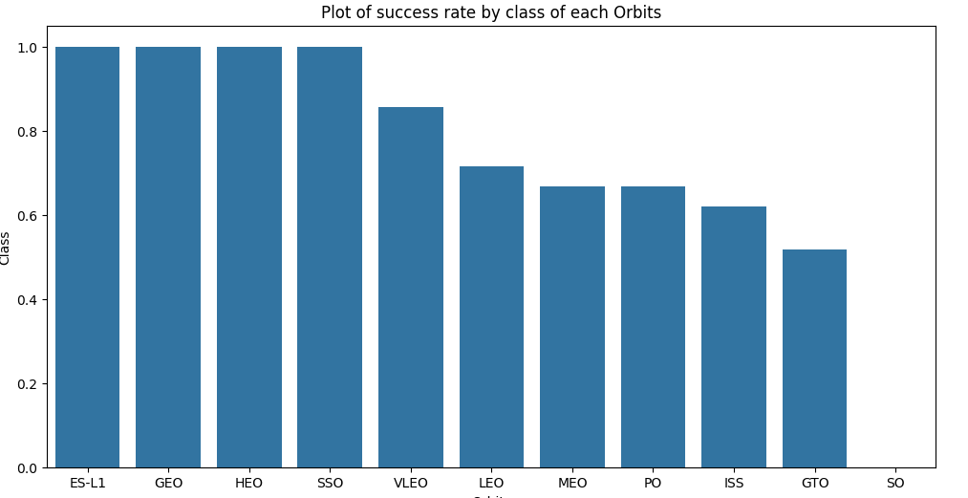
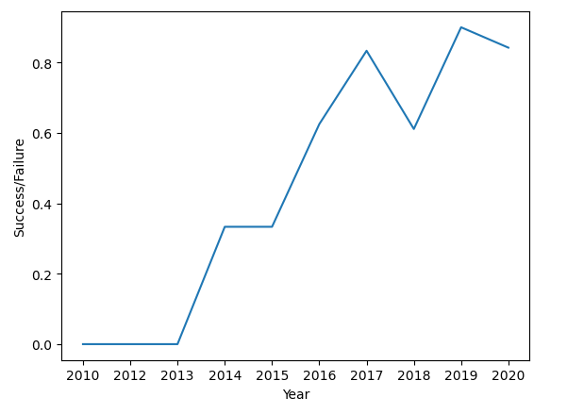
EDA with Data Visualization
We explored the data visualizing the relationship between Flightnumber and Payload mass, Flightnumber and Launch site, Launch site and Payload mass, Fightnumber and Orbit type, Payload mass and Orbit type,
A bar chart is created for the success rate of each orbit.
A line chart is created to get the average launch success trend.
GitHub reference: https://github.com/Jolanda412/Coursera/blob/f3ede770f50a4d1a116d5956d0d3afa35b2a5978/edadataviz.ipynb

Slide 12
EDA with SQL
The following SQL queries where performed:
Display the names of the unique launch sites in the space mission
Display 5 records where launch sites begin with the string ‘CCA’
Display the total payload mass carried by boosters launched by NASA (CRS)
Display average payload mass carried by booster version F9 v1.1
List the data when the first successful landing outcome in ground pas was achieved
List the names of the boosters which have success in drone ship and have payload mass greater than 3000 but less then 6000
List the total number of successful and failure mission outcomes
List the names of the boosters_versions which have carried the maximum payload mass
List the records which will display the month names, failure landing_outcomes in drone ship, booster versions, launch_site for the months in year 2015
Rank the count of landing outcomes between the data 2010-06-04 and 2017-03-20
GitHub reference: https://github.com/Jolanda412/Coursera/blob/ad107984226858851c5d3dd476c2516878b688ec/jupyter-labs-eda-sql-coursera_sqllite.ipynb

Slide 13
Build an Interactive Map with Folium
Markers, circles, lines and marker clusters were used with Folium Maps
Markers indicate points like launch sites
Circles indicate highlighted areas around specific coordinates like NASA Johnson Space Center
Marker clusters indicates groups of events in each coordinate, like launches in a launch site
Lines are used to indicate distances between two coordinates. In this case the launch site and the coastline
GitHub reference: https://github.com/Jolanda412/Coursera/blob/d0bbde0ff7c2f48a28dbe0efc572ffcf1599c7b7/lab_jupyter_launch_site_location.ipynb

Slide 14
Build a Dashboard with Plotly Dash
An interactive dashboard is built with Plotly dash.
A drop-down menu is created where the user can select all launch site or a specific launch site.
A pie chart is created and depending on which selection you have made in the drop-down menu you will see the success count for all Launch sites or for the selected Launch site.
A scatter chart is created and depending on which selection you have made in the drop-down menu you will see the success count on Payload mass for all sites or the selected site.
GitHub reference: https://github.com/Jolanda412/Coursera/blob/main/spacex_dash_app.py

Slide 15
Predictive Analysis (Classification)
Four classification models were compared: logistical regression, support vector machine, decision tree, and k nearest neighbors.
GitHub reference: https://github.com/Jolanda412/Coursera/blob/main/SpaceX_Machine%20Learning%20Prediction_Part_5.ipynb
Data preparation and standardization
Test each model with combinations of huperparameters
Comparison of results

Slide 16
Results
Exploratory data analysis results
SpaceX uses 4 different launch sites
The first launches were done to SpaceX itself and NASA
The average payload of a G9 v1.1 booster is 2,928 kg
The first success landing outcome happened in 2015 five years after the first launch
Many Falcon 9 booster versions were successful at landing in drone ships having payload above the average
Amost 100% of mission outcomes were successful
Two booster version failed at landing in drone ships in 2015: F9 v1.1 BH1012 and F9 v1.1 B1015
The number of landing outcomes becomes better as years passed.

Slide 17
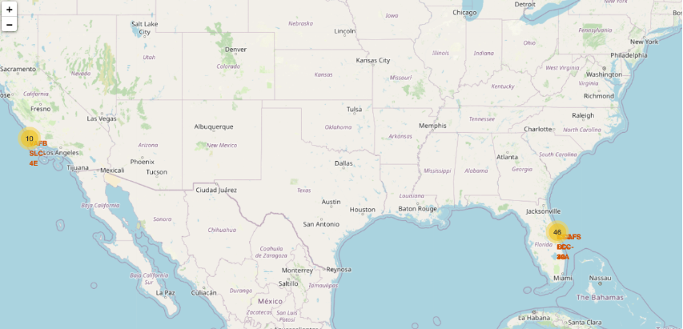
Results
Interactive analytics demo in screenshot
Using interactive analytics, it was possible to identify that launch sites are in safe places, near see, and have a good logistical infrastructure around.
Most launches are at east cost launch sites.

Slide 18
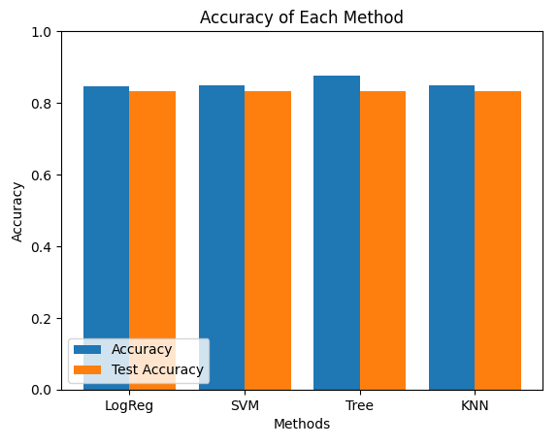
Results
Predictive analysis results:
Although all models have approximately the same accuracy, the Decision Tree Classifier is the best model to predict the successful landings, having an accuracy over 87%

Slide 19

Section 2

Slide 20
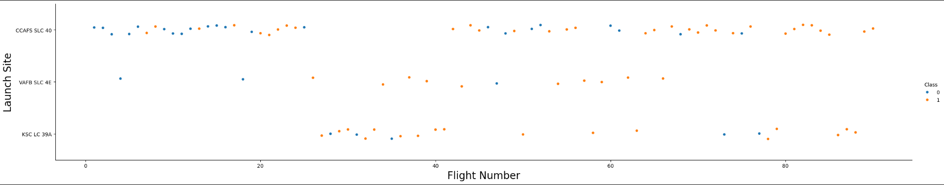
Flight Number vs. Launch Site
With time the success rate has increased for every Launch Site, especially for CCASF SLC-40, who takes on the majority of the launches.
The other 2 launch sites have a higher success rate but represent one third of the total launches.
The general success rate improved over time.

Slide 21
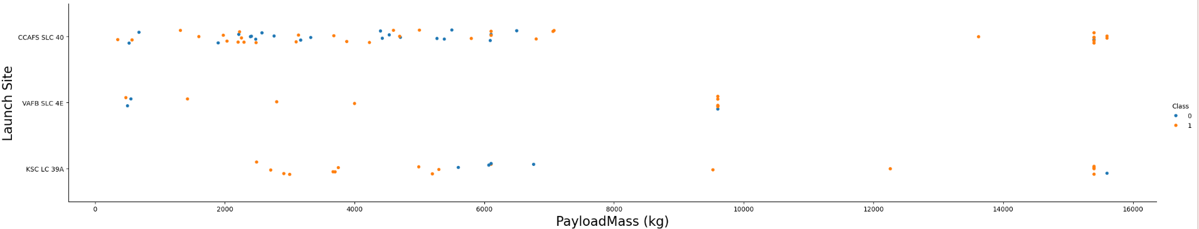
Payload vs. Launch Site
Payloads over 9000 kg have a high success rate
It seems that payloads over 12000 kg are not possible on launch site VAFB SLC 4E

Slide 22
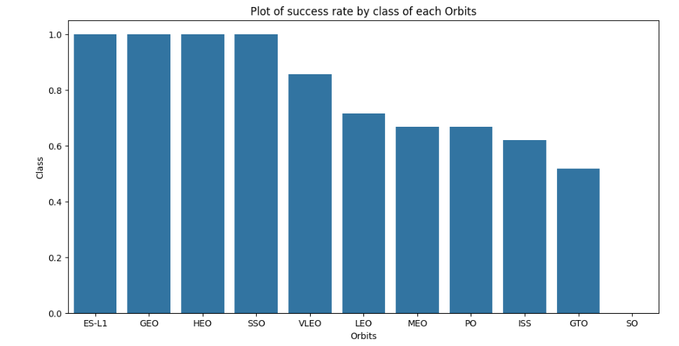
Success Rate vs. Orbit Type
The bar chart must be interpreted with the number of launches per orbit type
Orbit SO doesn't have any launches
ES-L1, GEO, HEO and SSO have the highest success rate

Slide 23
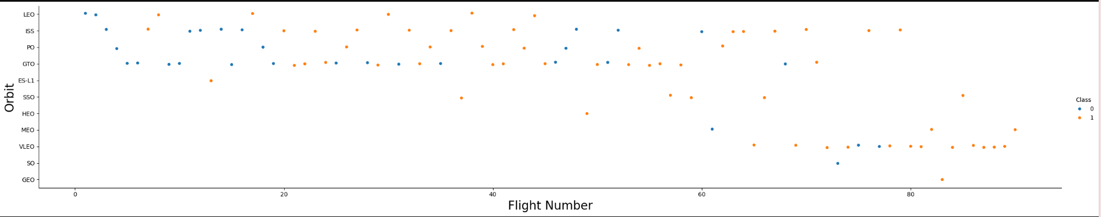
Flight Number vs. Orbit Type
Succes rate for all orbits improved over time.
Orbits with a higher success rate, has one or just a few launches.

Slide 24
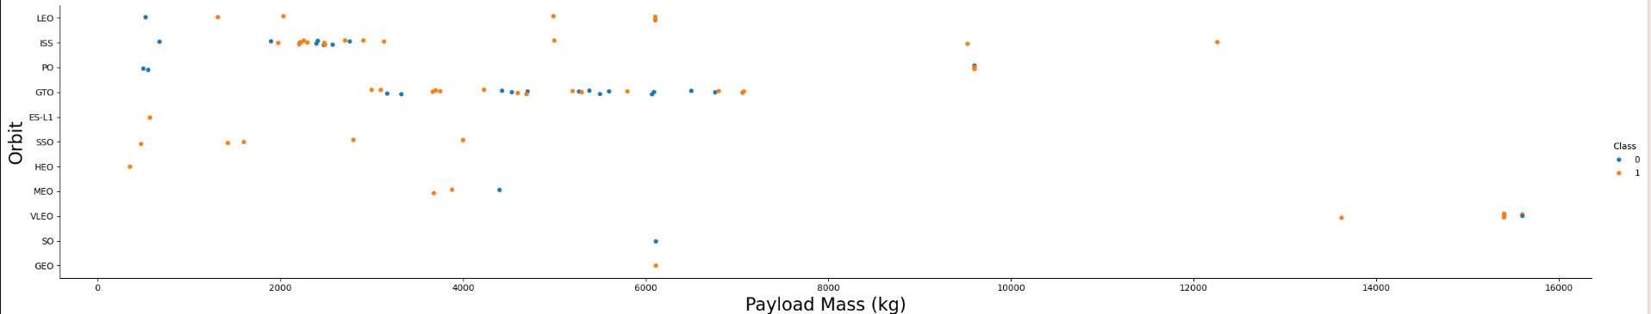
Payload vs. Orbit Type
Exist a visible limit of Payload around 7600 kg. Less than 10 launches exceeds that limit.
For GTO there seems to be no correlation.

Slide 25
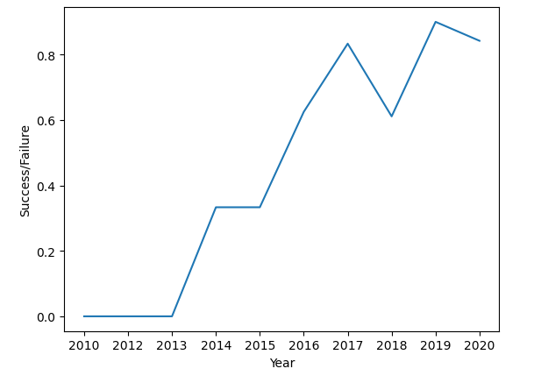
Launch Success Yearly Trend
Since 2013 the succes rate kept increasing, with a little hickup in 2018

Slide 26
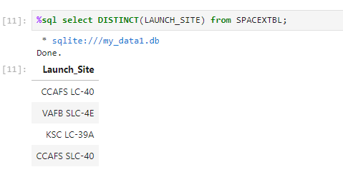
All Launch Site Names
There are four unique launch sites in the space mission

Slide 27
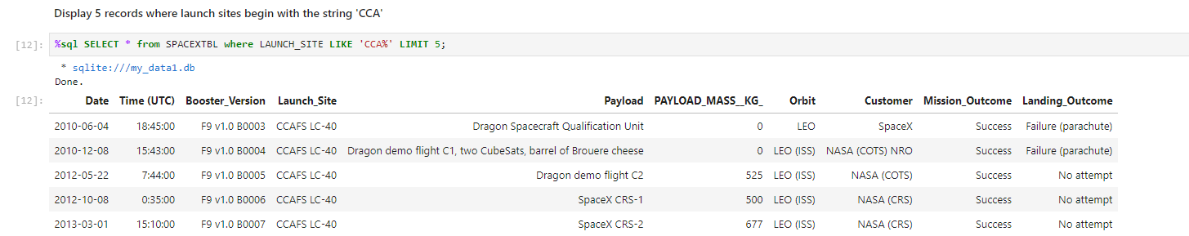
Launch Site Names Begin with 'CCA'
This query uses WHERE, LIKE, LIMIT

Slide 28
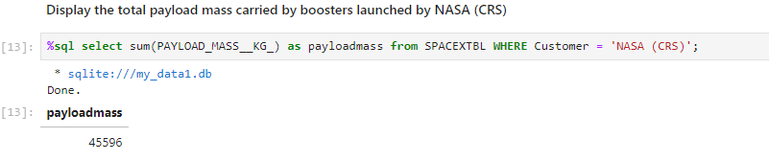
Total Payload Mass
Carried payload mass is 45.596kg
For the calculation the SUM function is used

Slide 29
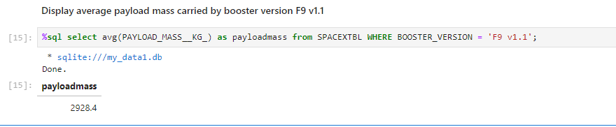
Average Payload Mass by F9 v1.1
Average payload mass carried by booster version F9 v1.1 is 2928,4 kg.

Slide 30
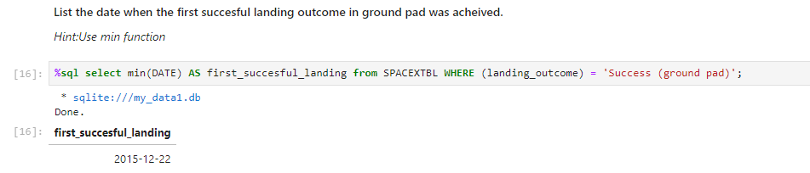
First Successful Ground Landing Date
The first successful landing outcome in ground pad was achieved on 22nd of December 2015

Slide 31
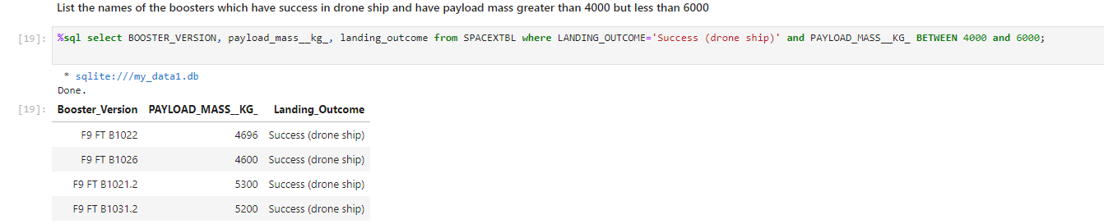
Successful Drone Ship Landing with Payload between 4000 and 6000
The names of the boosters who have successful drone ship landing with a payload between 4000 and 6000 kg.

Slide 32
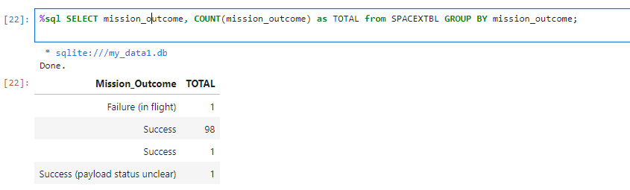
Total Number of Successful and Failure Mission Outcomes
The total number of successful and failure mission outcomes.
The queries uses a combination of the function COUNT and GROUP BY statement

Slide 33
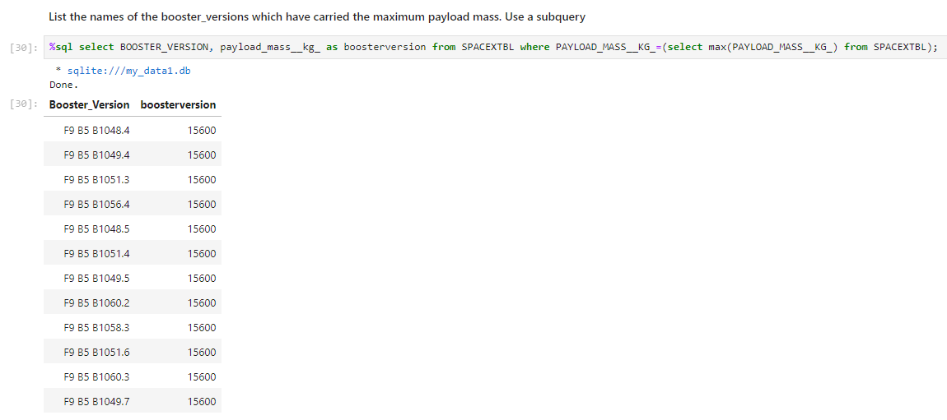
Boosters Carried Maximum Payload
List of the names of the booster which have carried the maximum payload mass
A subquery is used

Slide 34
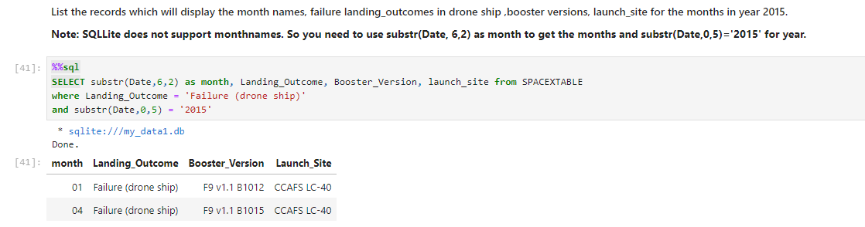
2015 Launch Records
Overview of the failed landing outcomes in drone ship, their booster versions and launch site names for the year 2015

Slide 35
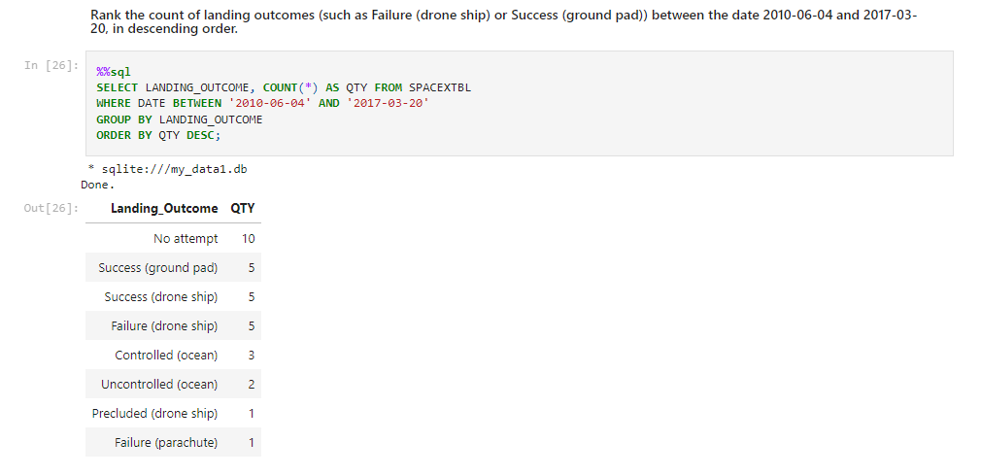
Rank Landing Outcomes Between 2010-06-04 and 2017-03-20
Landing outcomes in descending order.
The query uses COUNT, WHERE, BETWEEN and GROUP BY

Slide 36

Section 3

Slide 37
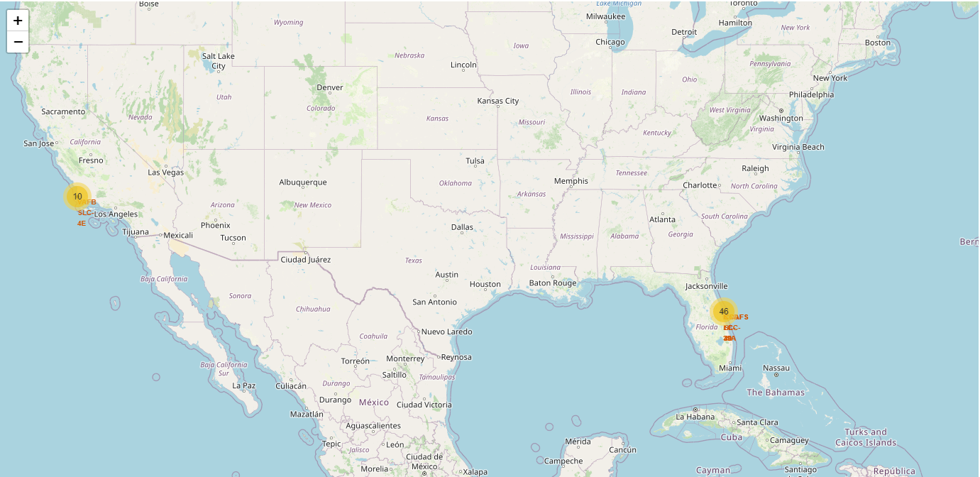
Map of all launch sites
Most launch sites are close to the coast.

Slide 38
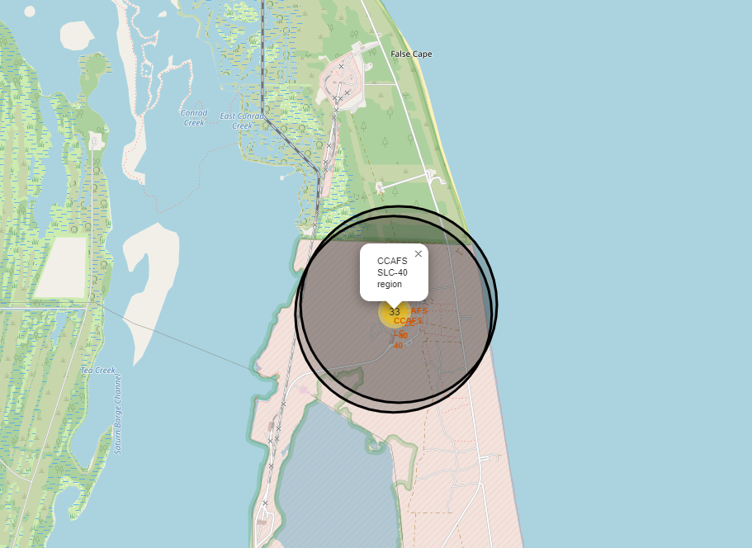
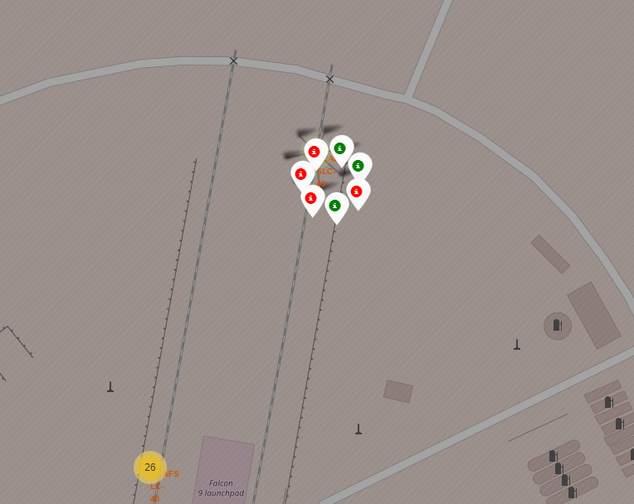
Succes/failed launches per site
On the second map if a marker is green, the launch was successful, if the marker is red, the launch failed.

Slide 39
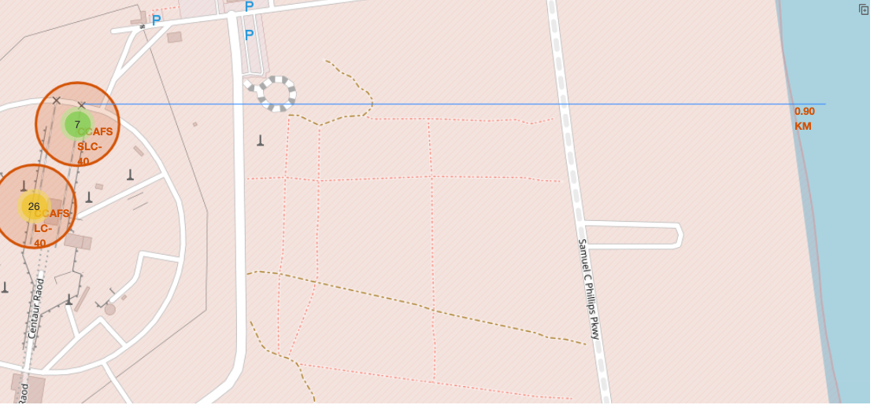
A launch site and the distance to the coast
Launch sites are near to railroads, roads and coastline. This is not only for easy access but for maintaining a safe distance from cities.

Slide 40

Section 4

Slide 41
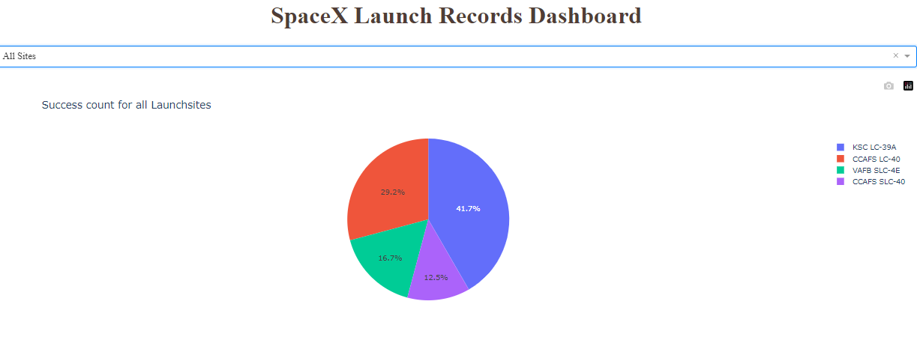
Total success launches by site
Site with the highest success rate is KSC LC-39A

Slide 42
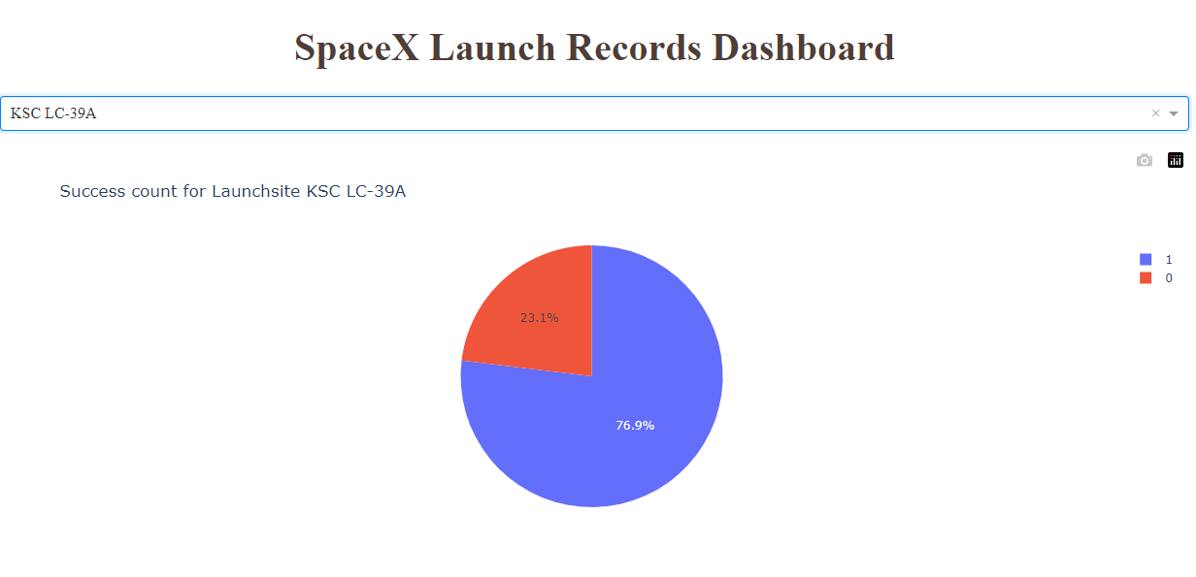
KSC LC-39A
The piechart for the launch site KSC LC-39A shows the site with the highest launch success rate

Slide 43
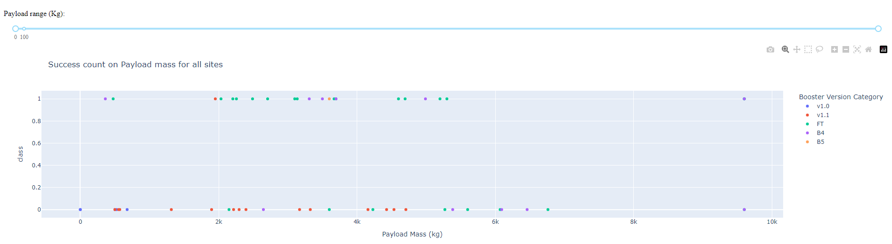
Payload vs Launch outcome
Scatter plot for all sites and the payload mass ranges.

Slide 44

Section 5

Slide 45
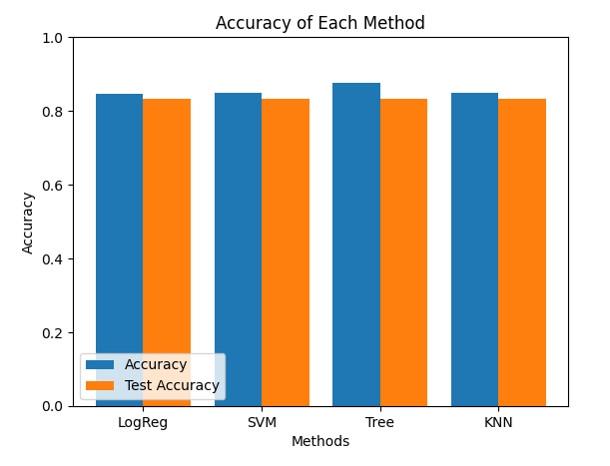
Classification Accuracy
Although all models have approximately the same accuracy, the Decision Tree Classifier is the best model to predict the successful landings, having an accuracy over 87%

Slide 46
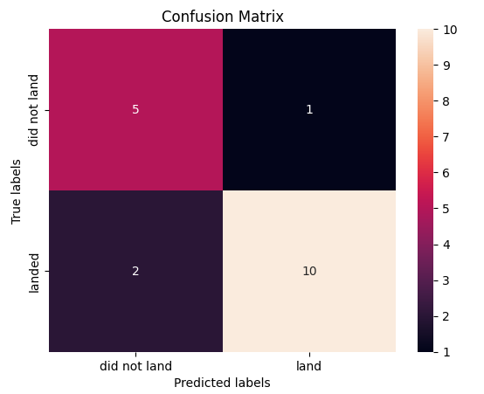
Confusion Matrix
The confusion matrix for the Decision Tree classifier

Slide 47
Conclusions
As all the algorithms are giving the approximately same accuracy, the all perform practically the same.
By using our machine learning model we can predict if the first stage of our competiro will land and determine the cost of a launch.

Slide 48
Appendix
For notebooks, datasets, scripts and everything else follow this GitHub link:
https://github.com/Jolanda412/Coursera

Slide 49


